Slide 1
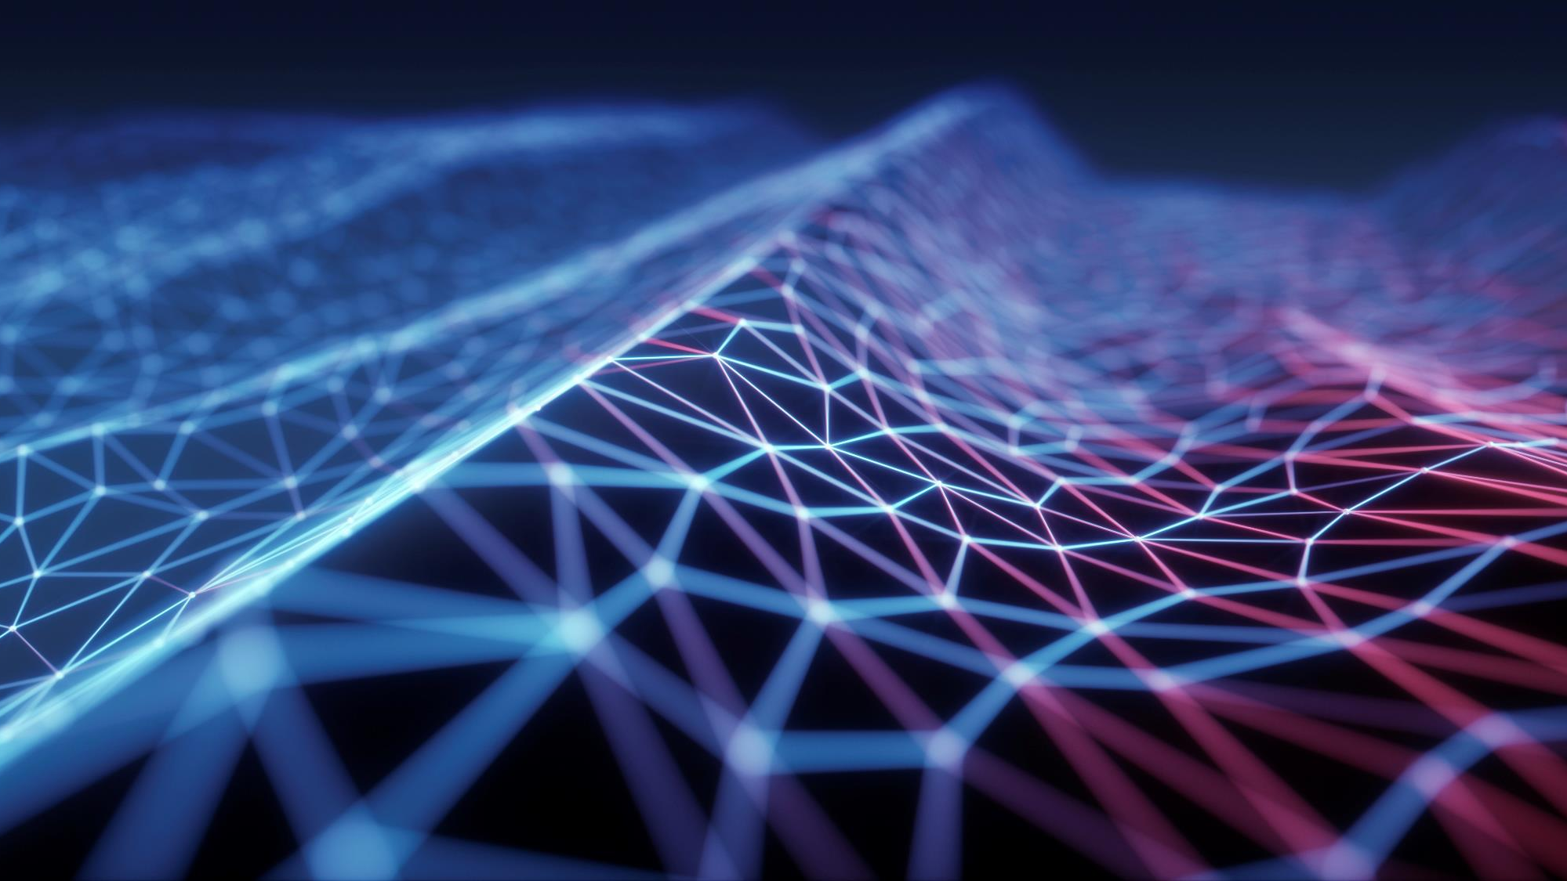
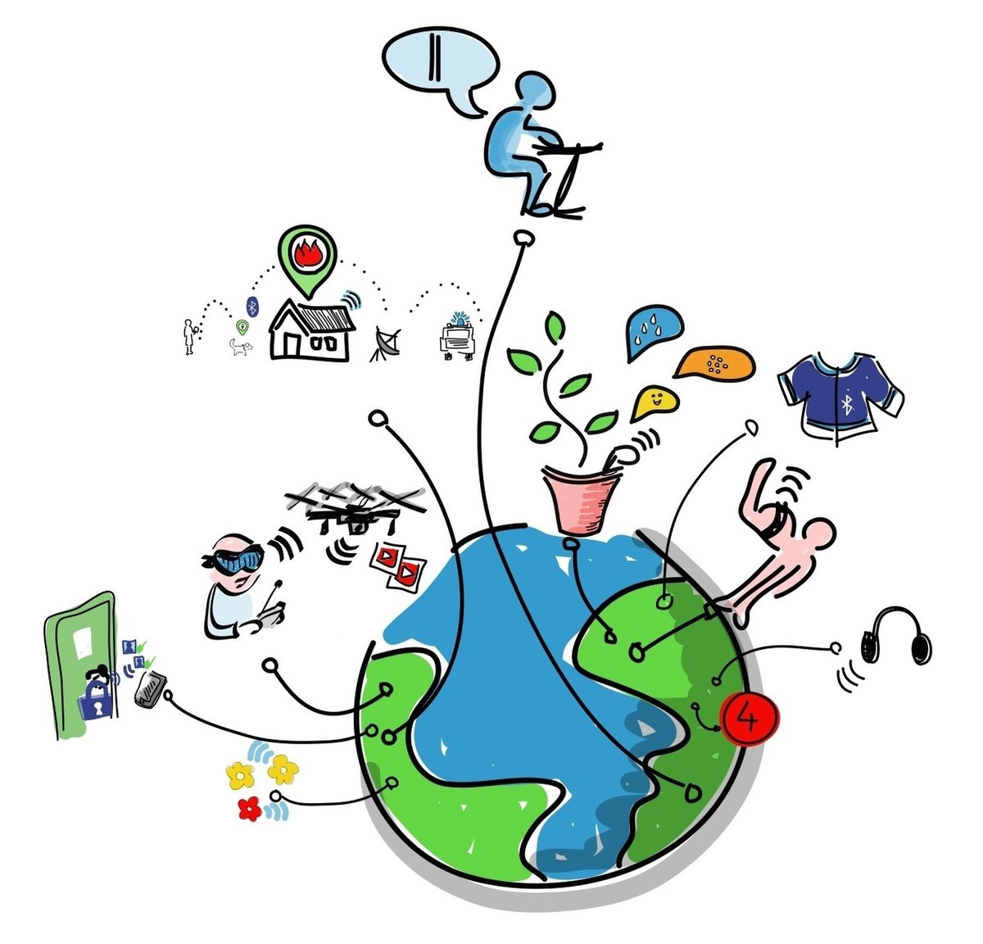
Internet of things (IOT)
Athukorala D.A.S.M
IT21169076

Slide 2
Agenda
Abstract
What is IOT
History
Cyber security in the IOT
Future of IOT
Delivery system by using drone
Smart security
Smart meter monitoring
Smart traffic management system
Face recognition bot
Another future projects

Slide 3
Abstract
Billion embedded computer devices may link to one another thanks to the Internet of Things (IoT). It consists of various gadgets that vary significantly in size, weight, functionality, and capacities, such as sensors, actuators, RFI tags, and cell phones. Their success is well-known, and IoT products and services are also increasing. In the Internet of Things, things may be found, controlled, and managed online. The IoT's most robust feature, this articulation, however, inherits all the security issues that the Internet currently has.
this presentation aims to establish a conceptual foundation for the Internet of Things future. The importance of measuring costs and benefits for companies, consumers, society, and the environment is underlined. The evaluation of usability by stakeholders in both user- and business-centric settings is studied as an unsolved subject. Finally, suggestions are given to both scholars and practitioners.

Slide 4
h
The collective network of connected devices and the technology that facilitates communication between devices and the cloud, as well as between the devices themselves.
WHAT IS INTERNET OF THINGS?

Slide 5
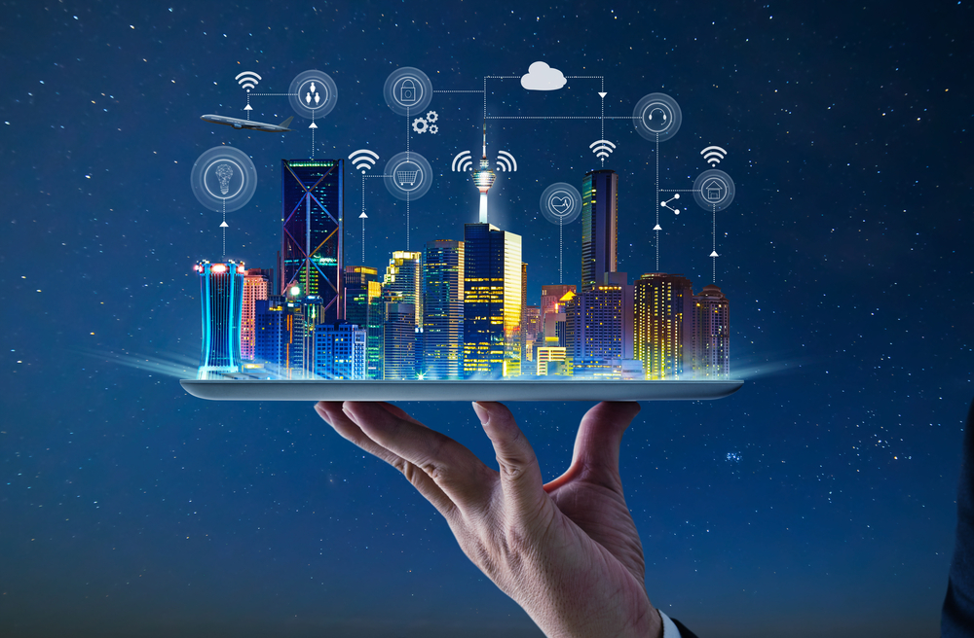
HISTORY
Kevin Ashton is an innovator and consumer sensor expert who coined the phrase “the Internet of Things” to describe the network connecting objects in the physical world to the Internet.

Slide 6
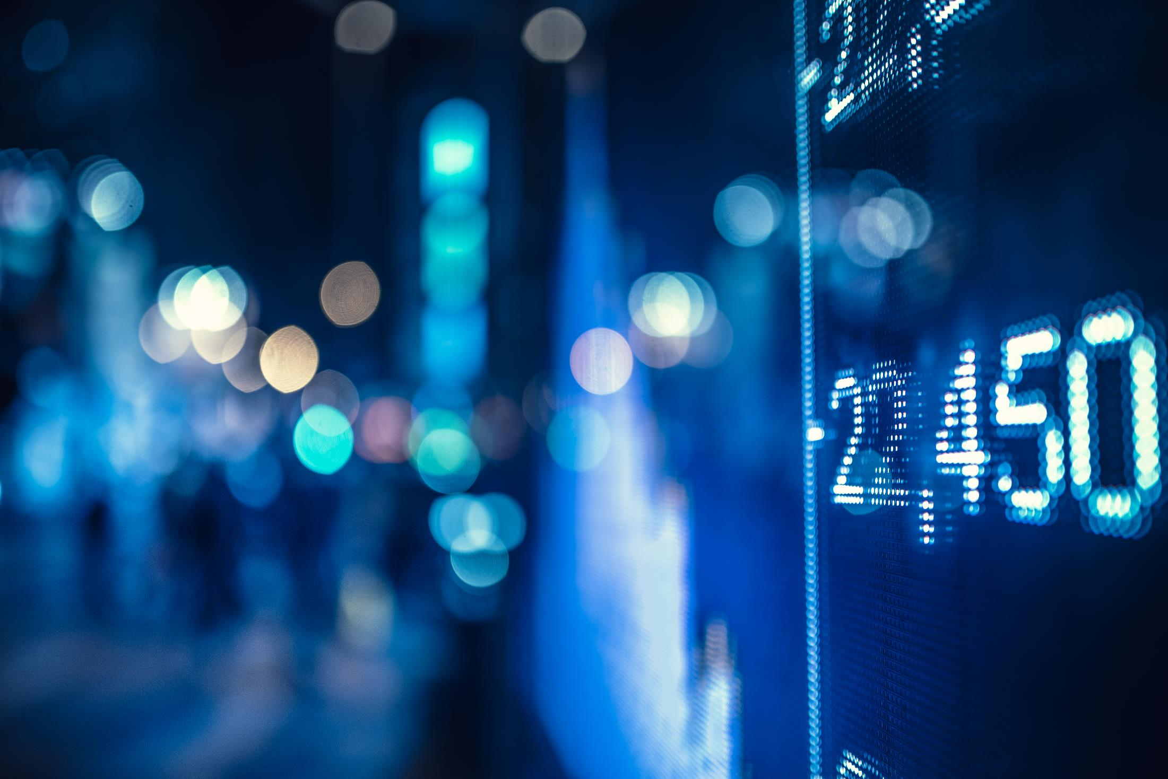
CYBER SECURITY IN THE INTERNET OF THINGS
The Cybersecurity for IoT Program develops standards, guidelines, and related technologies to create confidence in the IoT . This program's objective is to support worldwide innovation
Every connected device might be exploited without IoT security, from manufacturing robots to refrigerators

Slide 7
CYBER SECURITY IN THE INTERNET OF THINGS
IoT deployment faces its most significant hurdle in terms of cybersecurity
The Cybersecurity for IoT Program's mission is to cultivate trust in the IoT and foster an environment that enables innovation on a global scale through standards, guidance, and related tools.

Slide 8
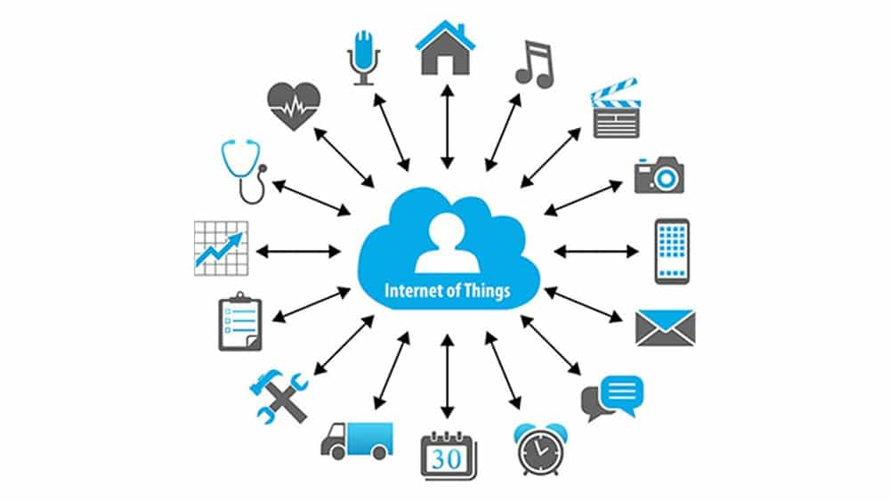
Future of internet of things

Slide 9
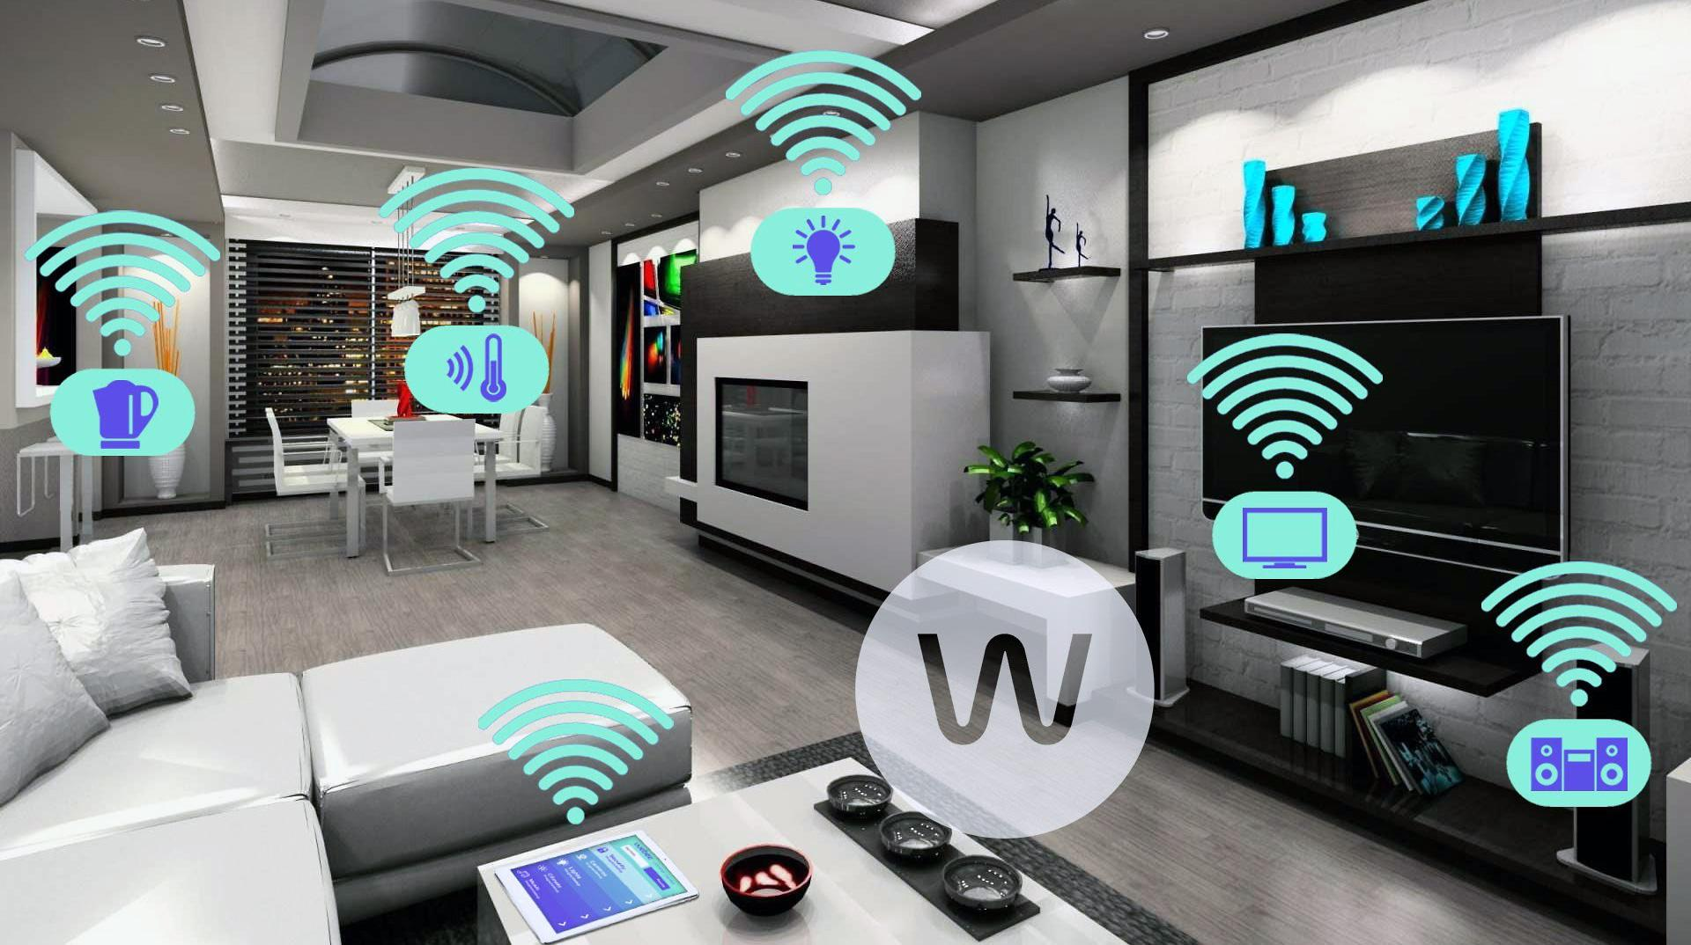
Designs smart house
The Internet of Things (IoT) may assist in designing smart homes in various ways, including energy consumption management, communication with appliances, emergency detection, home safety, accessible object searching, home security, etc.

Slide 10
Smart home
Environment control
Smart thermostat (e.g., Nest)
Air moisture
Smoke alarm
Flood detector
Lighting system
Drapes Sprinkler systems (outdoor)
Smart Energy HVAC
Gas meter
Electricity meter
Water meter

Slide 11
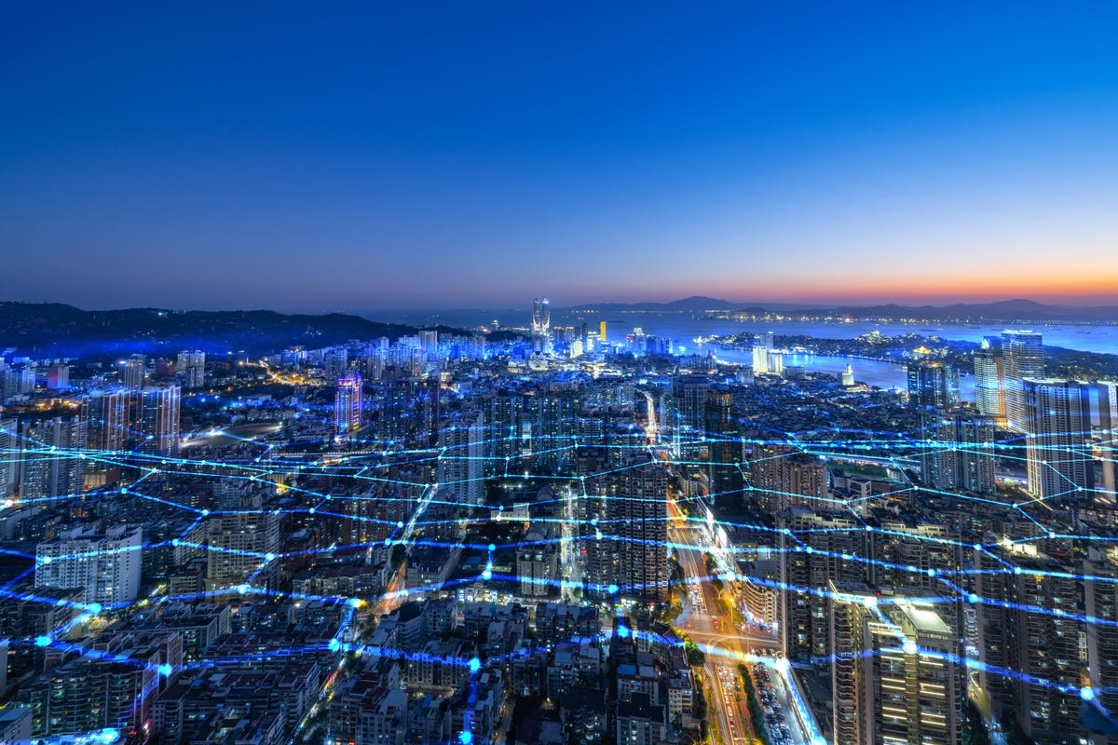
Design smart cities
The Internet of Things (IoT) can aid in the design of smart cities by monitoring air quality, recognizing emergency routes, illuminating the city efficiently, watering gardens, and other functions.

Slide 12
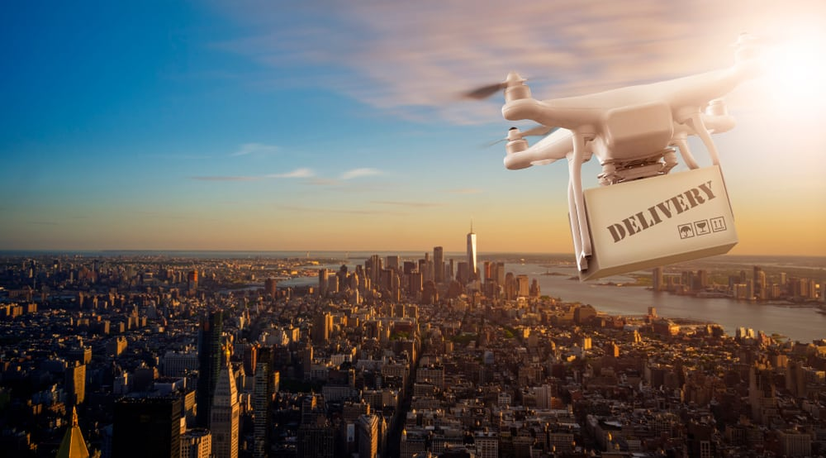
Intelligent delivery system (drone)
The drone may pick up the required item, fly there using G.P.S., descend, alert the customer before delivering it to their front door, and then return to the base .
Drone delivery can carry that weight easily, and organizations with multiple drone centers can significantly reduce the time and energy it takes to deliver a package

Slide 13
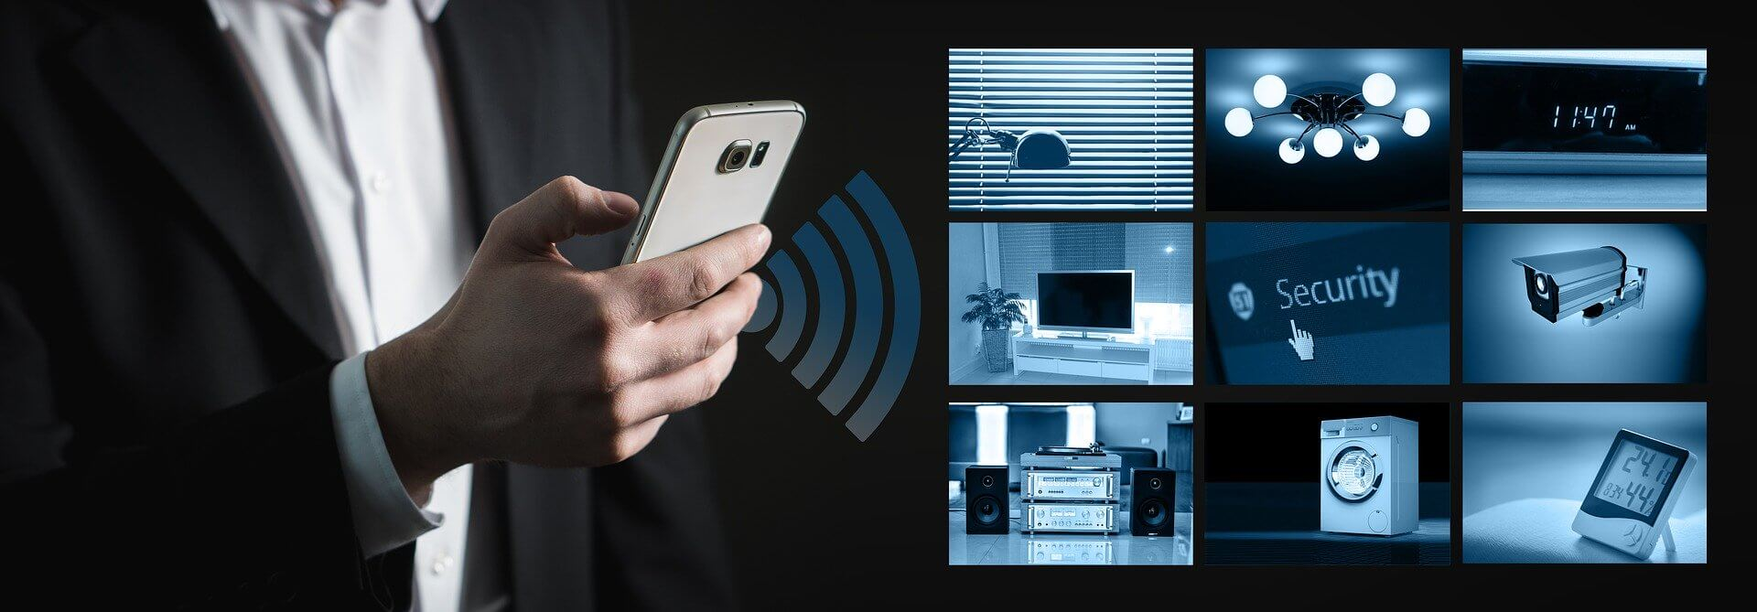
Smart Security
The IoT has several uses in the security and surveillance industry, including monitoring places, asset and human tracking, infrastructure and equipment maintenance, alarms, etc.

Slide 14
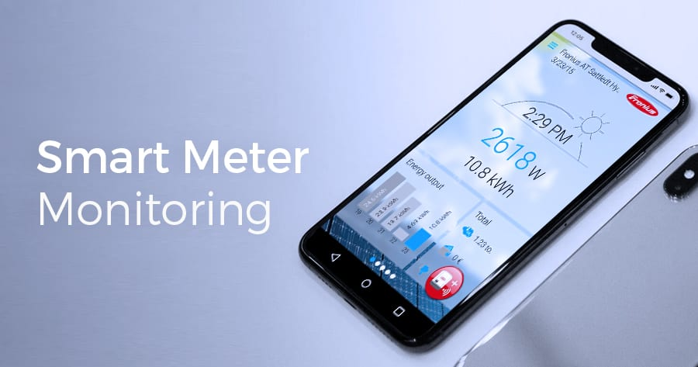
Smart metering and monitoring
A smart meter provides detailed information on consumption in order to reduce electricity bills and also increase knowledge about the status of the electricity grid, which improves its performance and the quality of service for customers.

Slide 15
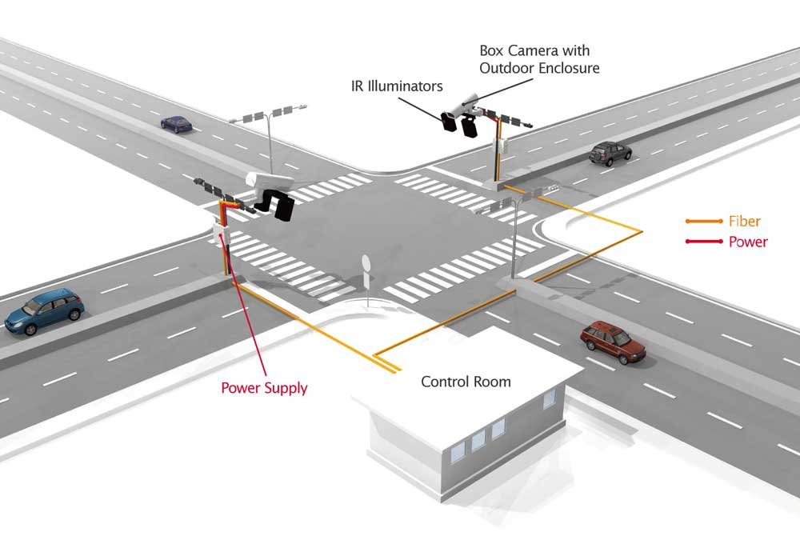
Smart Traffic Management System
A critical application of a smart traffic system using IoT is providing priority access to police, fire, and ambulance services.

Slide 16
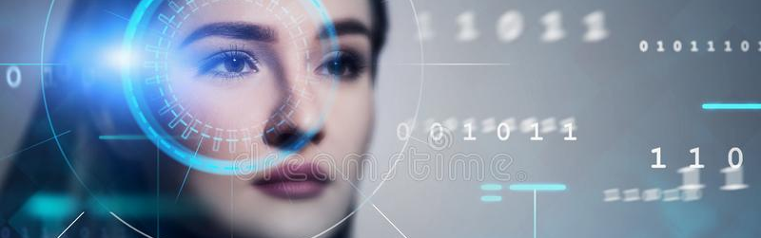
Face Recognition Bot
recognize that person’s voice and thus receive various commands for welcoming guests or for security purposes.

Slide 17
Future projects:
Smart Agriculture System
Weather Reporting System
Home Automation System
Face Recognition Bot
Smart Garage Door
Smart Alarm Clock
Air Pollution Monitoring System
Monitoring System
Smart Parking System
Smart Traffic Management System
Smart Cradle System
Smart Gas Leakage Detector Bot
Streetlight Monitoring System
Smart Anti-Theft System
Liquid Level Monitoring System
Night Patrol Robot
Health Monitoring System

Slide 18
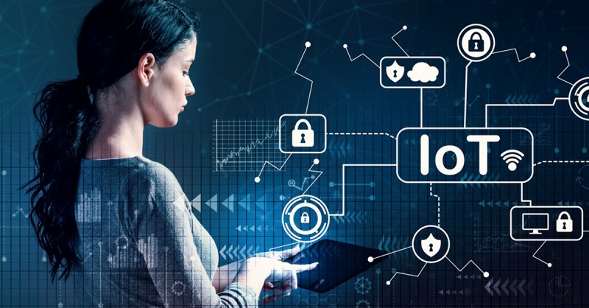
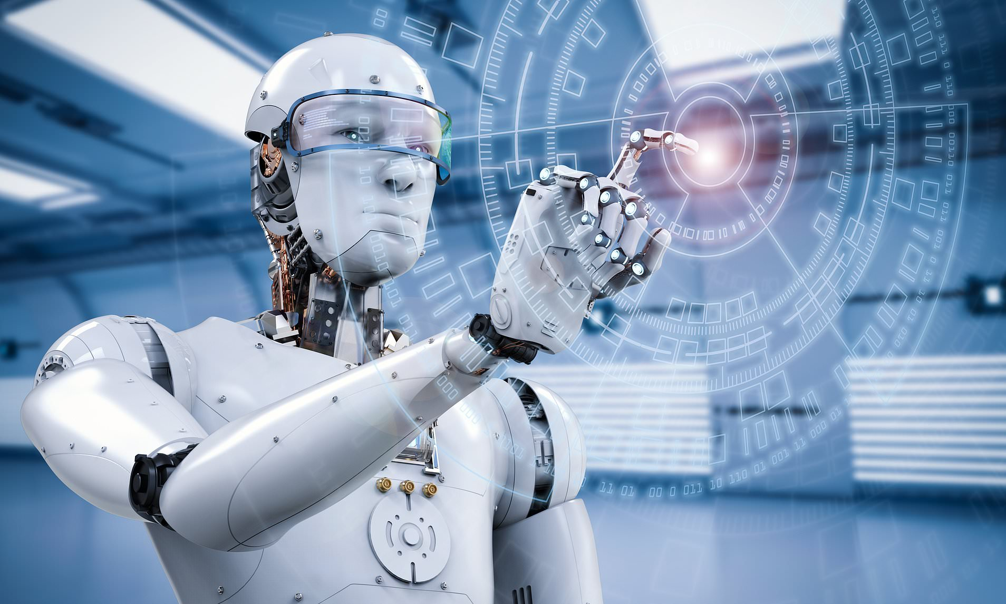
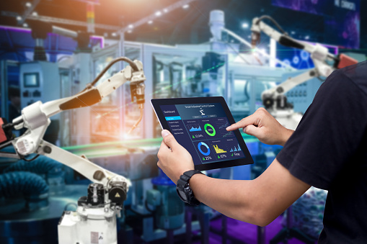

Slide 19
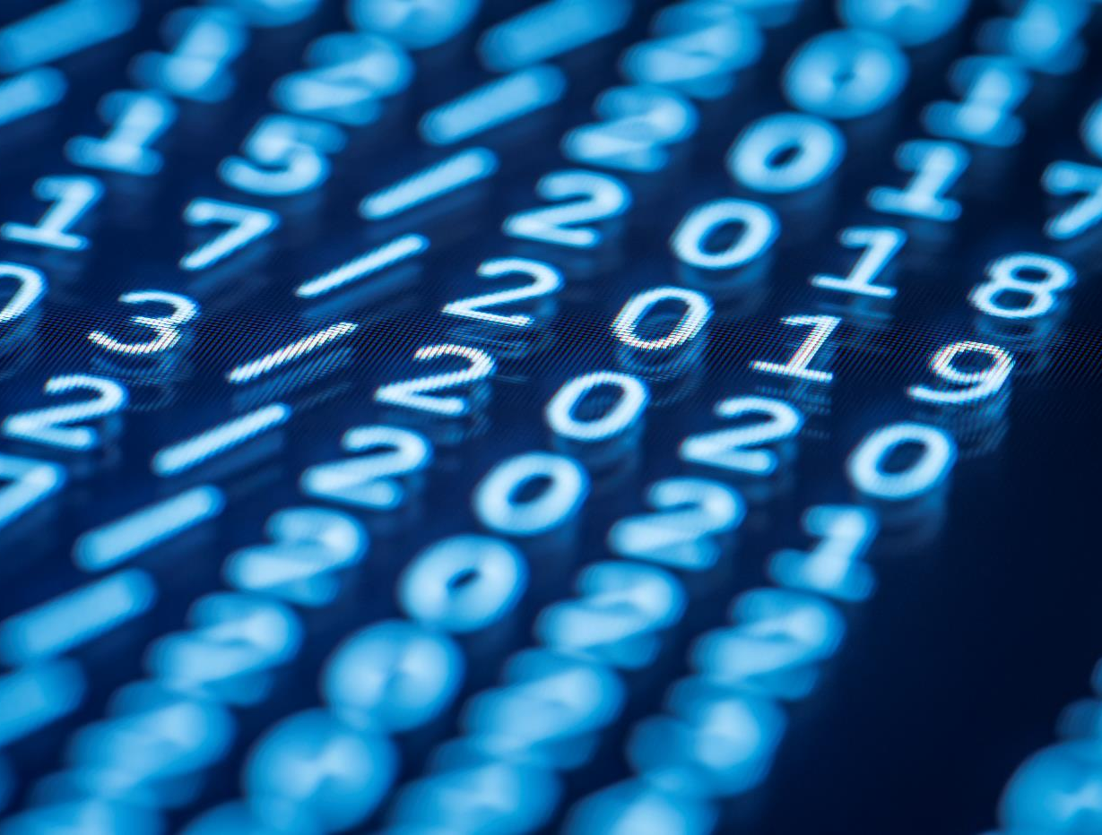
Thank You
ATHUKORALA D.A.S.M

